Slide 1

Unifying Concepts of Animal
Structure and Function
Unit 5; Chapter 21

Slide 2
Learning Objectives 1
Define and compare anatomy and physiology and explain why the two are usually studied together.
Define tissues, organs, and organ systems and describe the relationships among them.
Describe the four main categories of animal tissues, noting examples of each and distinguishing between their structures and functions.

Slide 3
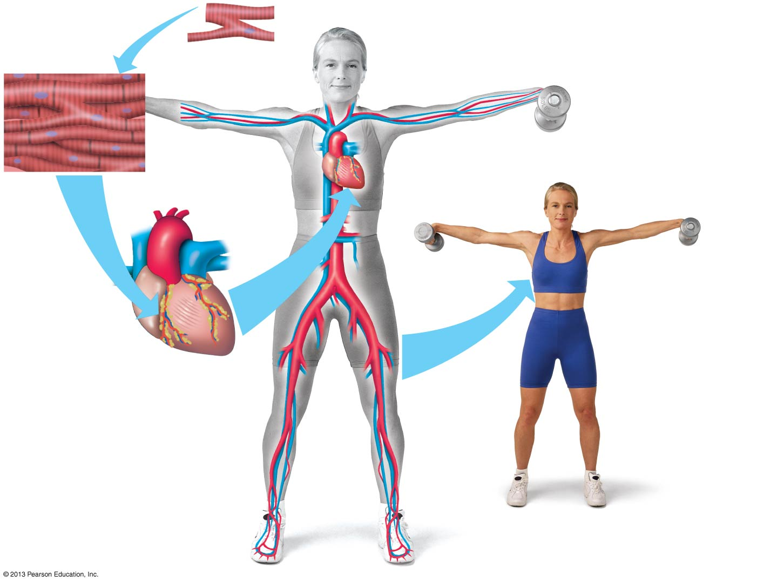
Structural Hierarchy
Cellular Level:
Muscle cell
Cells
Tissues (组织)
Orangs (器官)
Organ Systems
Organism
Tissue Level:
Cardiac muscle（心肌）
Organ Level:
Heart
Organism Level
(Whole Body Level):
Multiple organ
systems
functioning
together
System Level:
Circulatory system

Slide 4
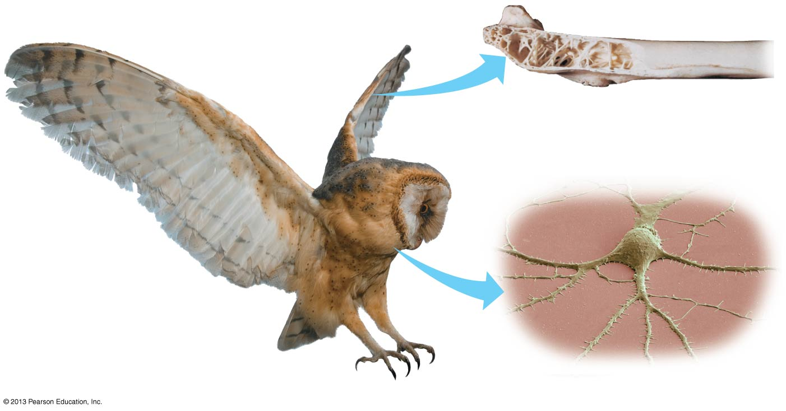
Anatomy and Physiology: Structure Fits Function
Anatomy (解剖学) is the study of the structure of an organism’s parts.
Physiology (生理学) is the study of the function of those parts.
(b) At the organ level
(a) At the organism level
(c) At the cellular level

Slide 5
Tissues
An integrated group of similar cells, performs a specific function, enabled by its special overall structure.
Four main categories of tissue:
  Epithelial Tissue (上皮组织)
  Connective Tissue (结缔组织)
  Muscle Tissue
  Nervous Tissue

Slide 6
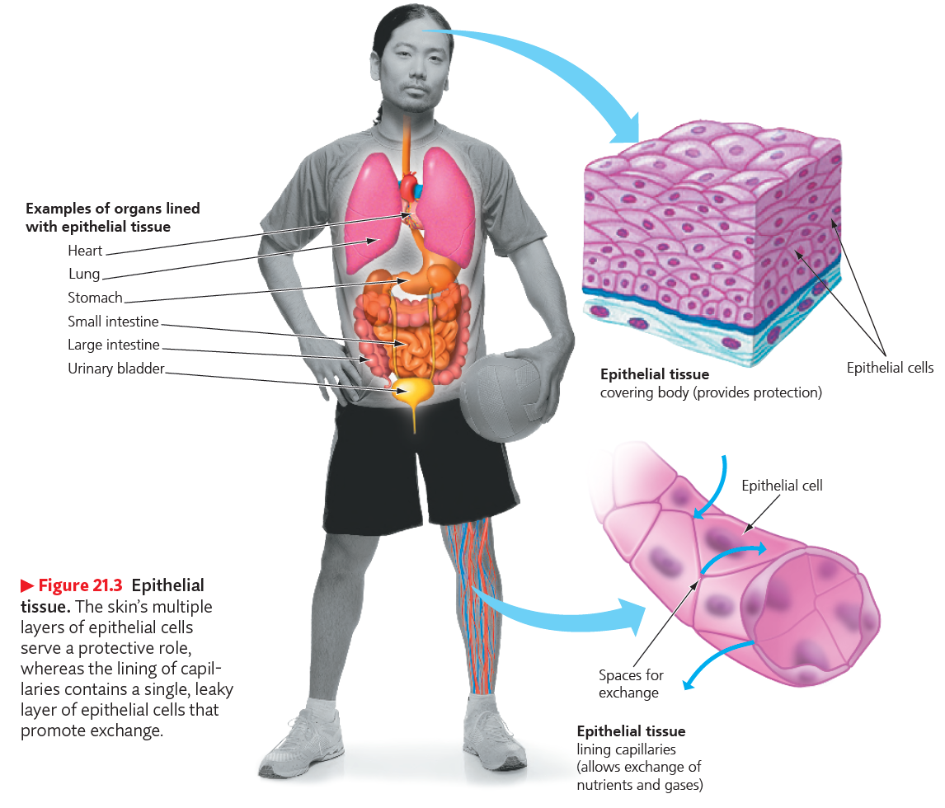
Epithelial Tissue (上皮组织)
As tightly linked layered protective barrier
Also known as epithelium
Covers the surface of the body and lines organs and cavities within the body
Continuously renewed
  Divide rapidly
  Environmental exposure
  80% of all cancers
    Carcinomas
    The five most common cancers—breast, prostate, lung, colon, and rectum
As a single thin and leaky layer

Slide 7
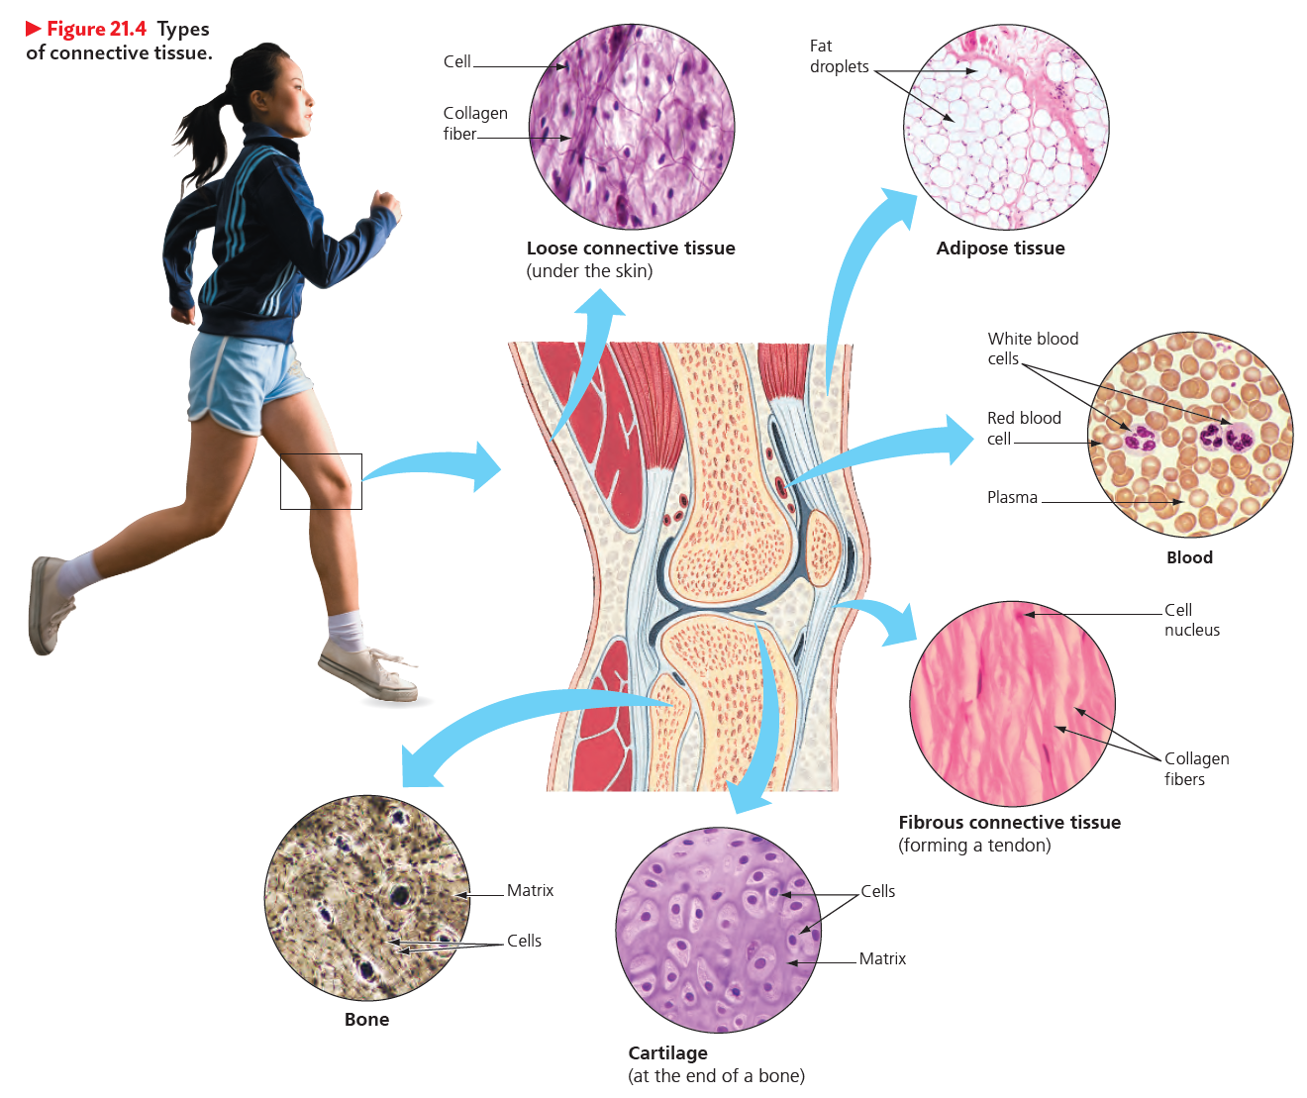
Connective Tissue
(结缔组织)
To join (connective) and support other tissues
A sparse population of cells in an extracellular matrix (细胞外间质)

Slide 8
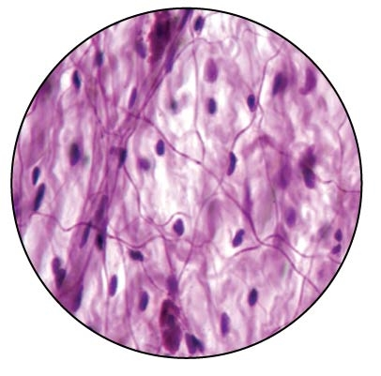
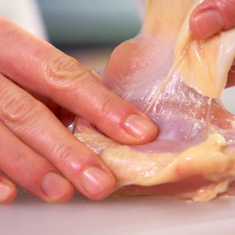
Loose Connective Tissue
Most widespread connective tissue in the bodies of vertebrates (animals with backbones, including humans)
Binds epithelia to underlying tissues
Provides strength and elasticity
Loose connective tissue
(under the skin)
Cell: fibroblasts
Collagen fiber
(胶原纤维)

Slide 9
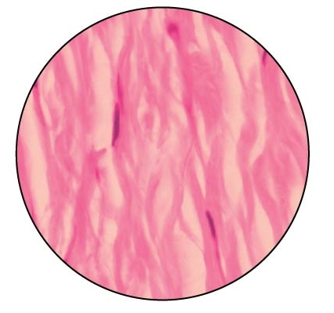
Fibrous Connective Tissue
A dense matrix of collagen
Forms tendons (肌腱) and ligaments (韧带)
  Tendons, attach muscles to bones
  Ligaments, securely join bones together at joints
Cell:
Fibroblasts
Fibrous connective tissue
(forming a tendon)
Collagen Fibers

Slide 10
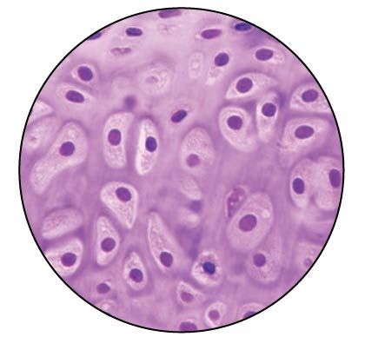
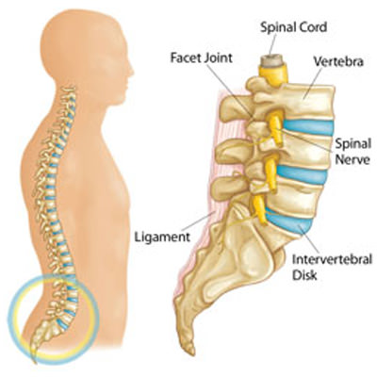
Cartilage (软骨)
Cartilage
(at the end of a bone)
Strong but flexible
Functions as a flexible, boneless skeleton
No blood vessels, so after injuries it heals very slowly
Ear, nose, voice box
Forms the shock-absorbing pads that cushion the ends of bones including the vertebrae (脊椎) of the spinal column (脊柱)
Cells
Matrix

Slide 11
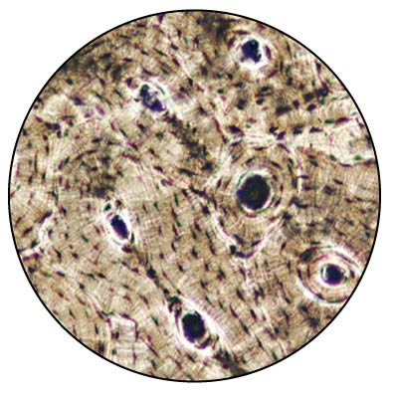
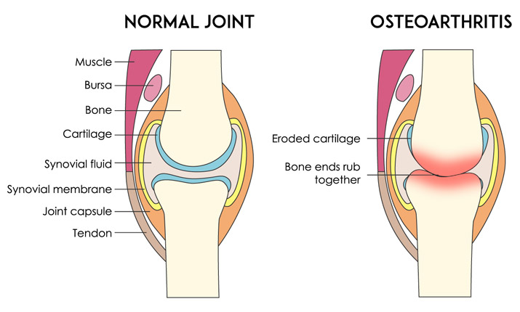
Bone
A rigid connective tissue
A dense matrix of collagen fibers hardened with deposits of calcium salts
Osteoblasts vs. osteoclasts
Matrix
Cells

Slide 12
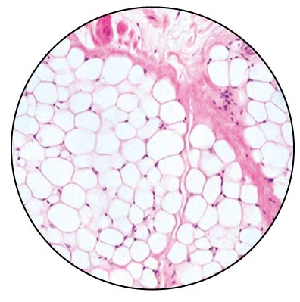
Adipose Tissue
Stores fat in closely packed cells of a sparse matrix
Insulates and cushions the body
Lipid droplets, lipid-rich cellular organelles
Adipose Tissue
Fat
droplets

Slide 13
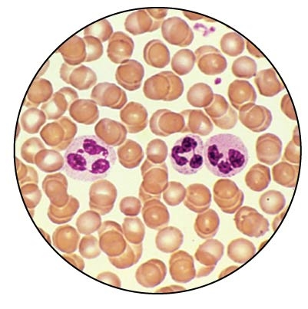
Blood
Cells suspended in a liquid matrix called plasma
Transport substances in the plasma
Seal broken blood vessels
In immunity
White blood cells
(WBC)
Red blood cells
(RBC)
Plasma

Slide 14
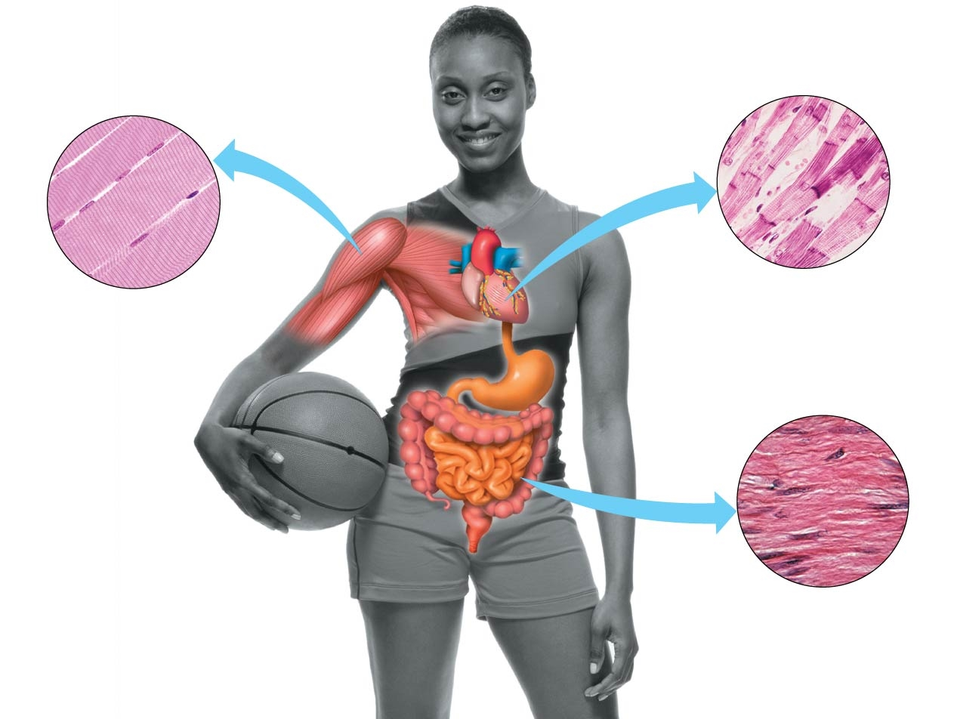
Muscle Tissue
Consists of bundles of long, thin, cylindrical cells called muscle fibers
The most abundant tissue in most animals
Three types
Skeletal muscle
Cardiac muscle
(心肌)
Smooth muscle
(平滑肌)

Slide 15
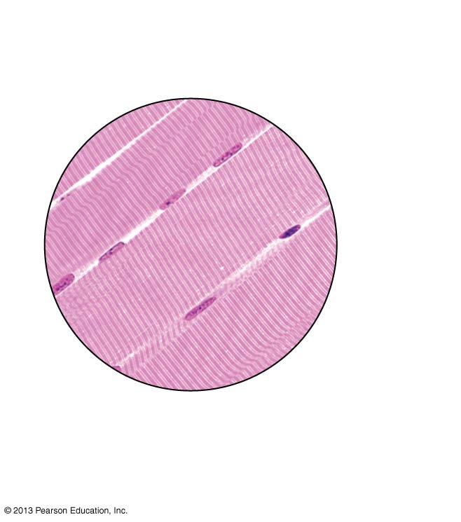
Skeletal Muscle (骨骼肌)
Unit of
muscle
contraction
Muscle fiber
(cell)
Attached to bones by tendons
Responsible for voluntary movements
Striated because the contractile proteins form a banded pattern (sarcomere as basic unit)
Multinucleated, developed by fusion
Muscle regeneration (repair)
Nuclei

Slide 16
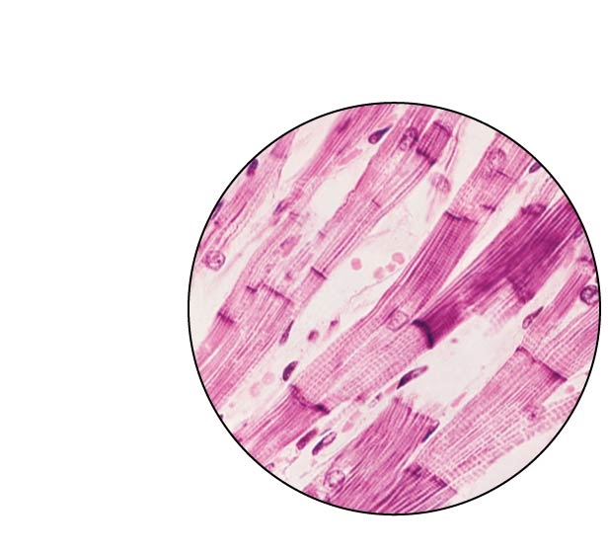
Cardiac Muscle
Only in heart tissue, for the heart contraction
Striated and branched
Single nucleus
Involuntary
Unable to regenerate
Junction between
two cells
Muscle
fiber

Slide 17
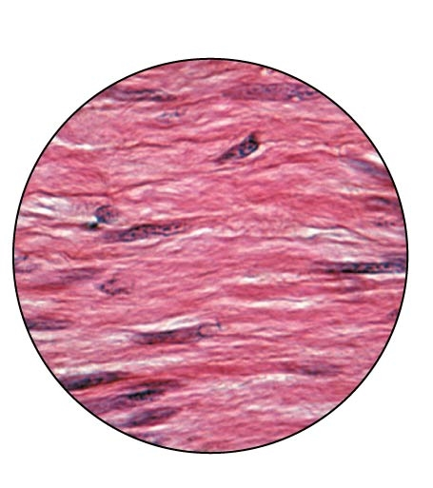
Smooth Muscle
Lack of obvious stripes
Can contract slowly for a long period of time
In the walls of viscera (various organs such as intestines) and blood vessels
Involuntary
Muscle fiber
Nucleus

Slide 18
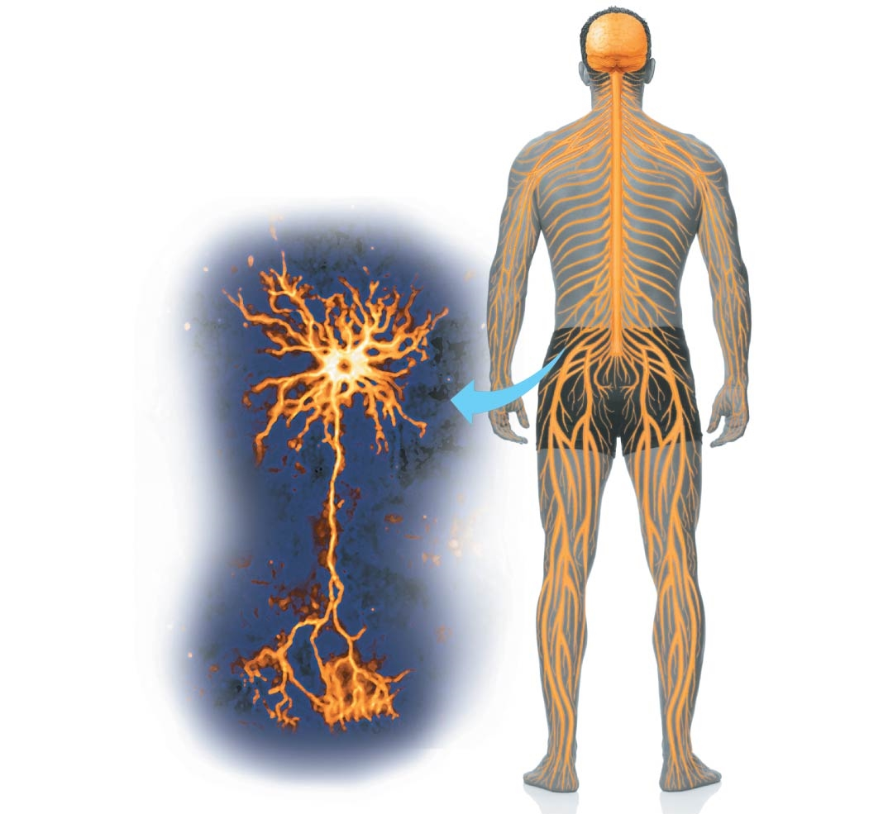
Nervous Tissue
Brain
For information transmission and body coordination
In brain and spinal cord (脊髓) and nerves connect to the rest of the body
Neuron (神经元), or nerve cell as the basic unit
Neurons function in circuits.
Spinal cord
Signal-receiving
extensions
Cell body
Nerve
Signal-
transmitting
extension

Slide 19
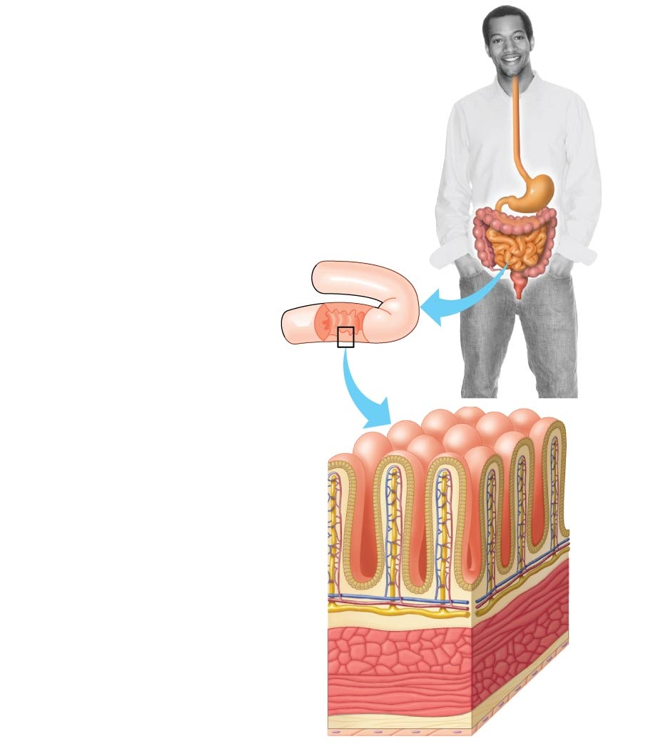
Organ
An organ consists of two or more tissues packaged into one working unit that performs a specific function.
  The heart, liver, stomach, brain, and small intestines, etc.
Small intestine
(cut open)
Organ Systems
Epithelial tissue
Organ systems are teams of organs that work together and perform vital body functions.
Connective tissue
(containing blood
and lymph vessels (淋巴管))
Smooth muscle tissue
(two layers)
Epithelial
tissue
Connective tissue

Slide 20
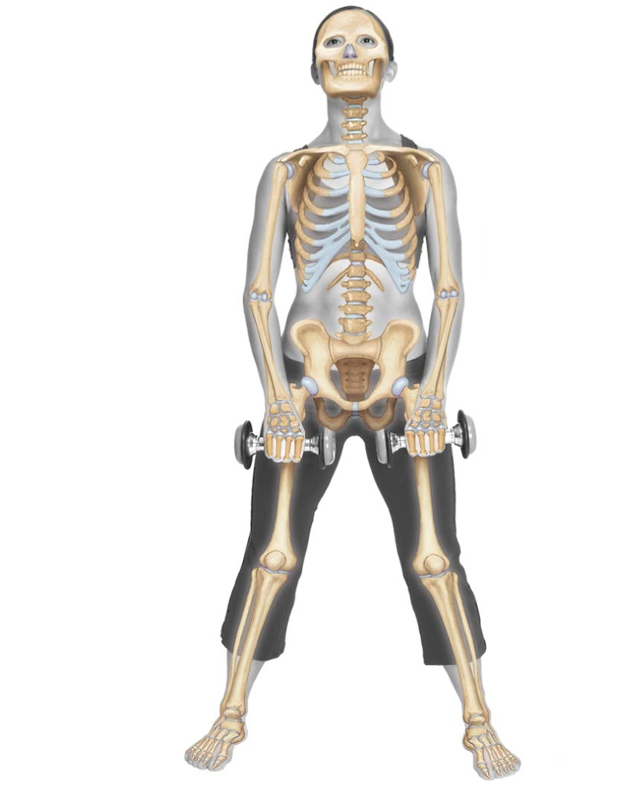
Skeletal System: Supports Body and Anchors Muscles
Bone
Cartilage

Slide 21
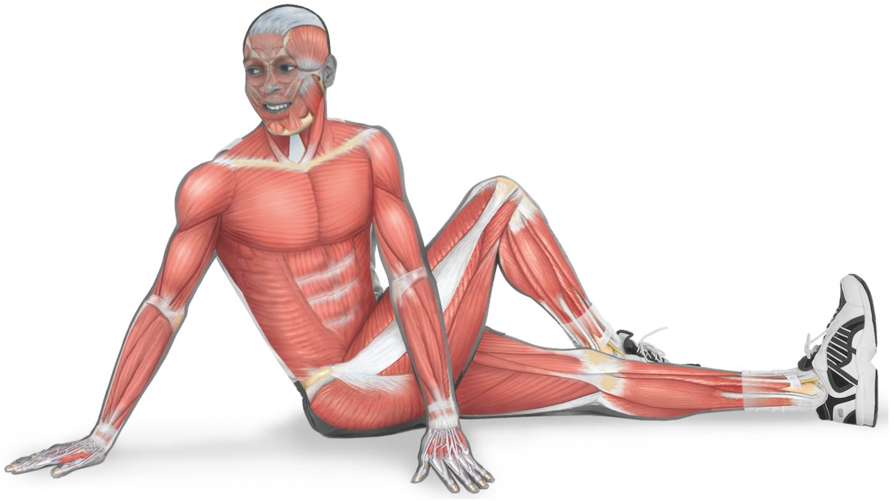
Muscular System: Moves the Body
Skeletal muscles

Slide 22
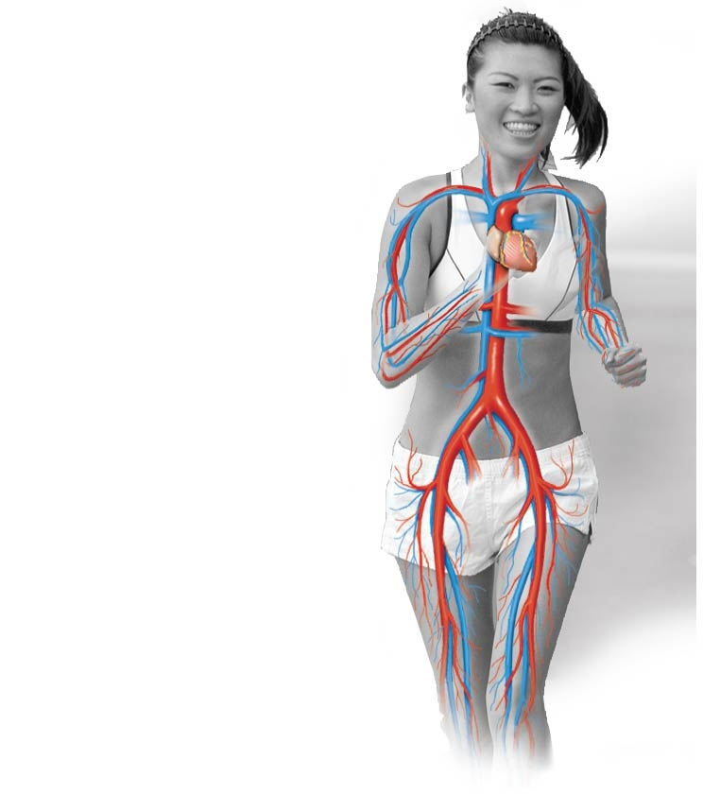
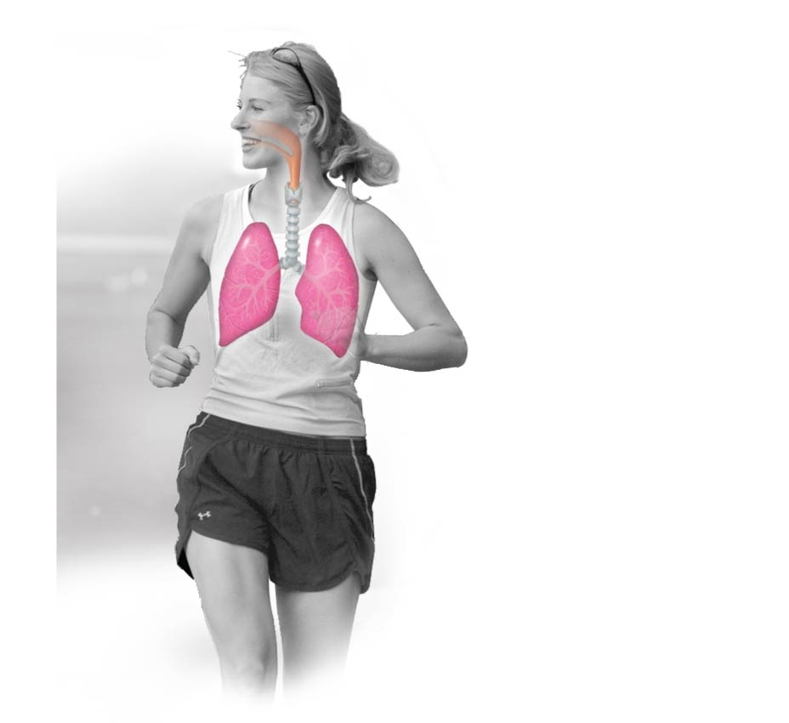
Circulatory System: Transports Substances throughout Body
Respiratory System: Exchanges O₂ and CO₂ between Blood and Air
Nasal cavity（鼻腔）
Pharynx（咽）
Larynx（喉）
Heart
Trachea（气管）
Bronchus（支气管）
Lung
Blood vessels

Slide 23
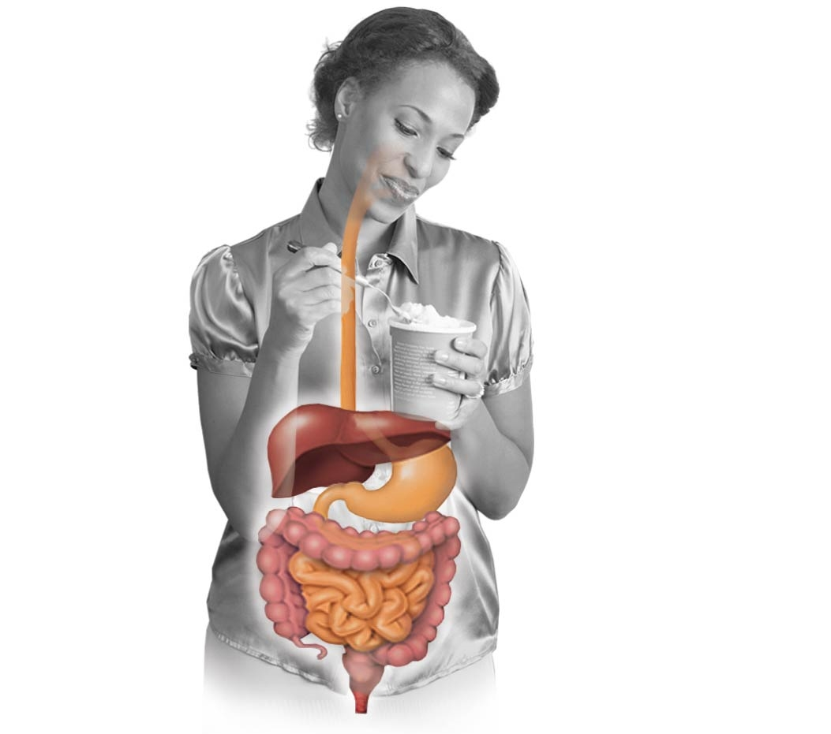
Digestive System: Breaks Down Food and Absorbs Nutrients
Mouth
Esophagus（食道）
Liver
Stomach
Large intestine
Small intestine
Anus（肛门）

Slide 24
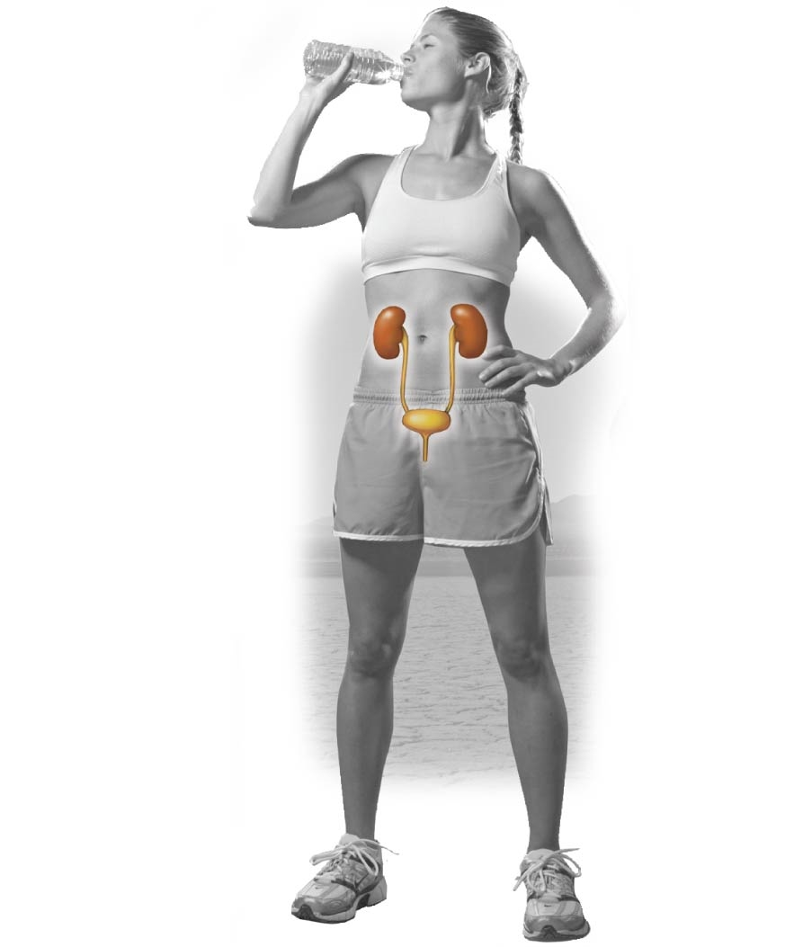
Urinary System (泌尿系统): Rids Body of Certain Wastes
Kidney
Urinary
bladder（膀胱）
Ureter（尿管）
Urethra（尿道）

Slide 25
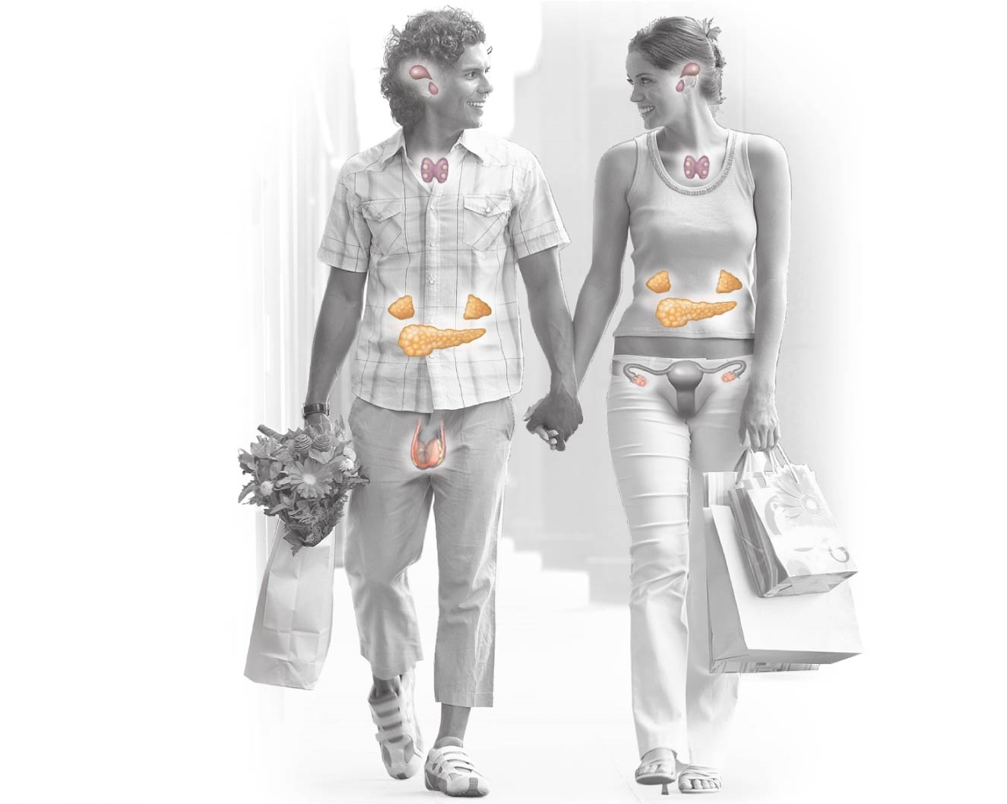
Endocrine System (内分泌系统): Secretes Hormones
Hypothalamus（下丘脑）
Pituitary gland（脑垂体）
Parathyroid gland（甲状旁腺）
Thyroid gland（甲状腺）
Adrenal gland（肾上腺）
Pancreas（胰腺）
Ovary（卵巢）
(female)
Testis（睾丸） (male)

Slide 26
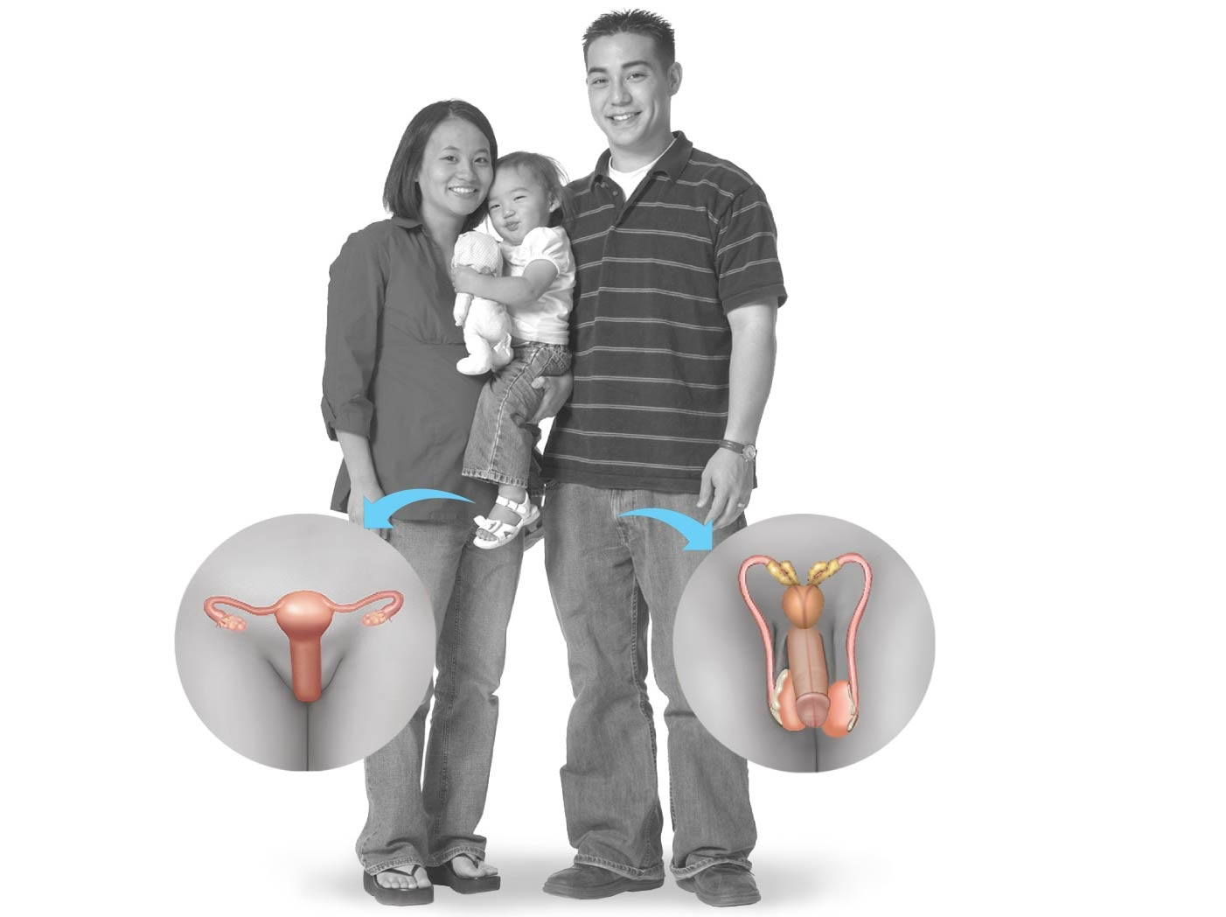
Reproductive System: Produces Gametes and Offspring
Seminal vesicles
（精囊）
Prostate gland (前列腺)
Oviduct（输卵管）
Vas deferens (输精管)
Ovary
Penis（阴茎）
Uterus
Urethra
Vagina（阴道）
Testis

Slide 27
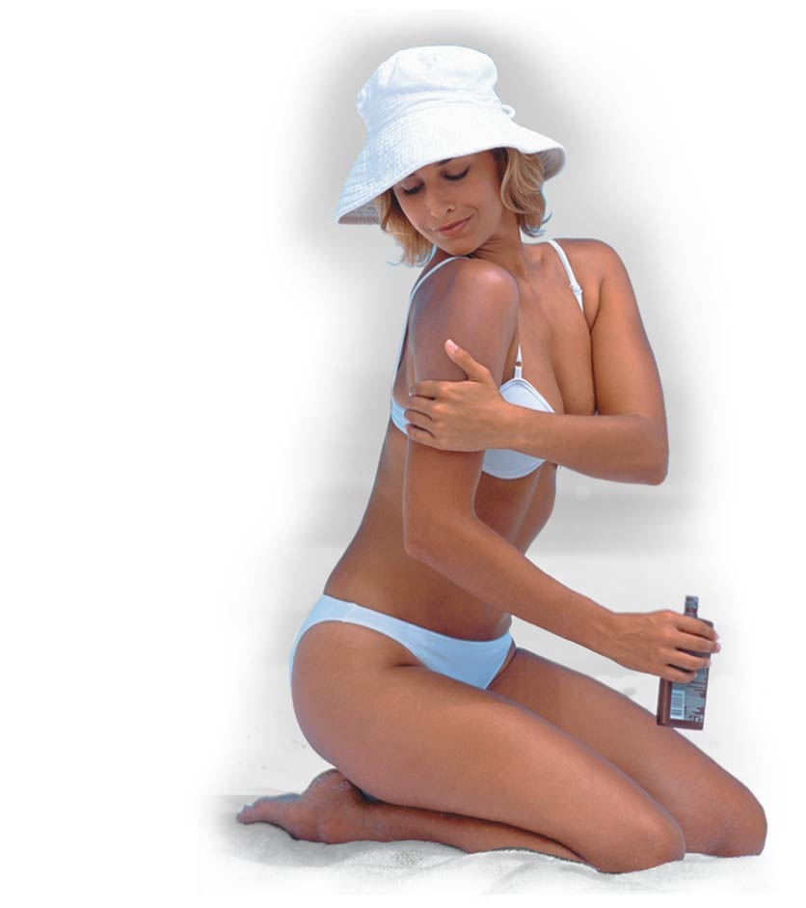
Integumentary System: Protects Body
Hair
Skin
Nail

Slide 28
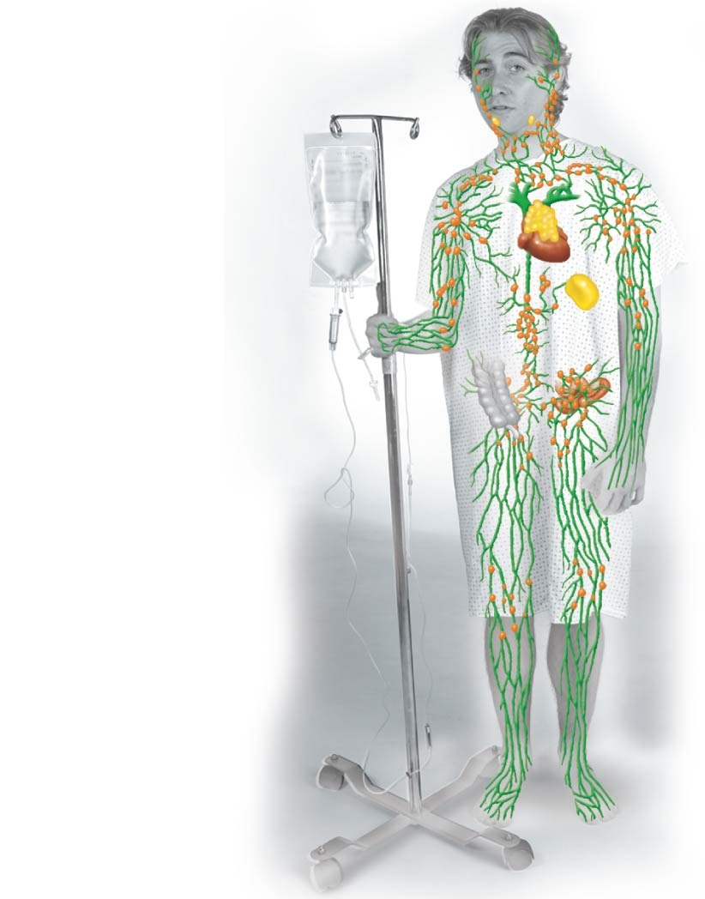
Lymphatic (淋巴) and Immune System: Defends Against Disease
Thymus（胸腺）
Spleen（脾脏）
Lymph nodes（淋巴结）
Lymphatic
vessels

Slide 29
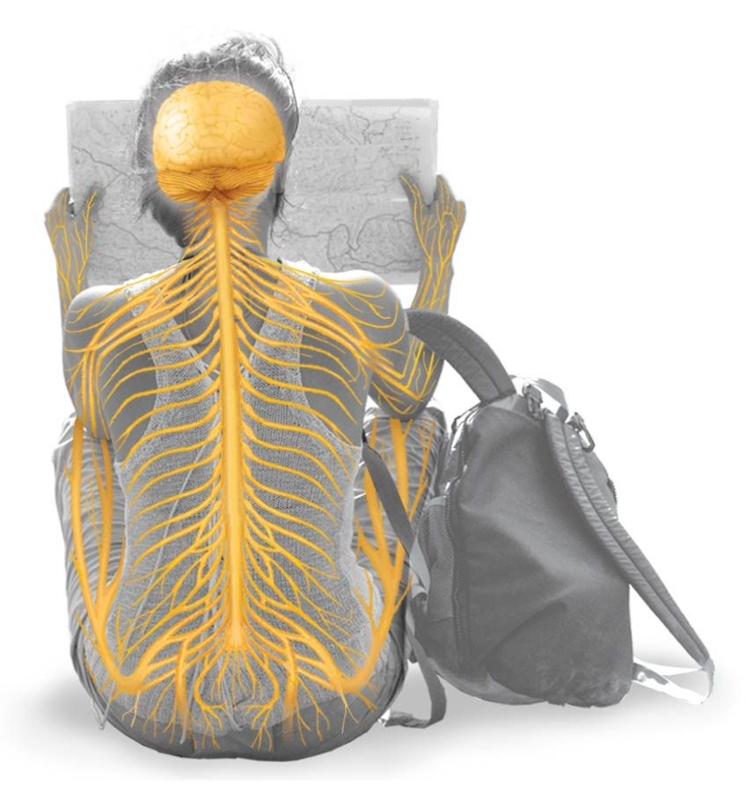
Nervous System: Processes Sensory Information and Controls Responses
Brain
Sense organ (ear)
Spinal cord（脊髓）
Nerves

Slide 30
Nervous, Sensory, and
Locomotor Systems
Unit 5; Chapter 27

Slide 31
Learning Objectives 2
Describe the structures and functions of neurons, nervous tissue, and organs, and how they are organized into and work together in the central and peripheral nervous systems.
Describe how electrical signals are sent through a neuron and into a receiving cell, including the cellular structures and chemicals needed, and how drugs can alter transmission of electrical signals.
Describe the organization, structures, and functions of the central, peripheral, and autonomic nervous systems.
Describe the structures and functions of the brain.

Slide 32
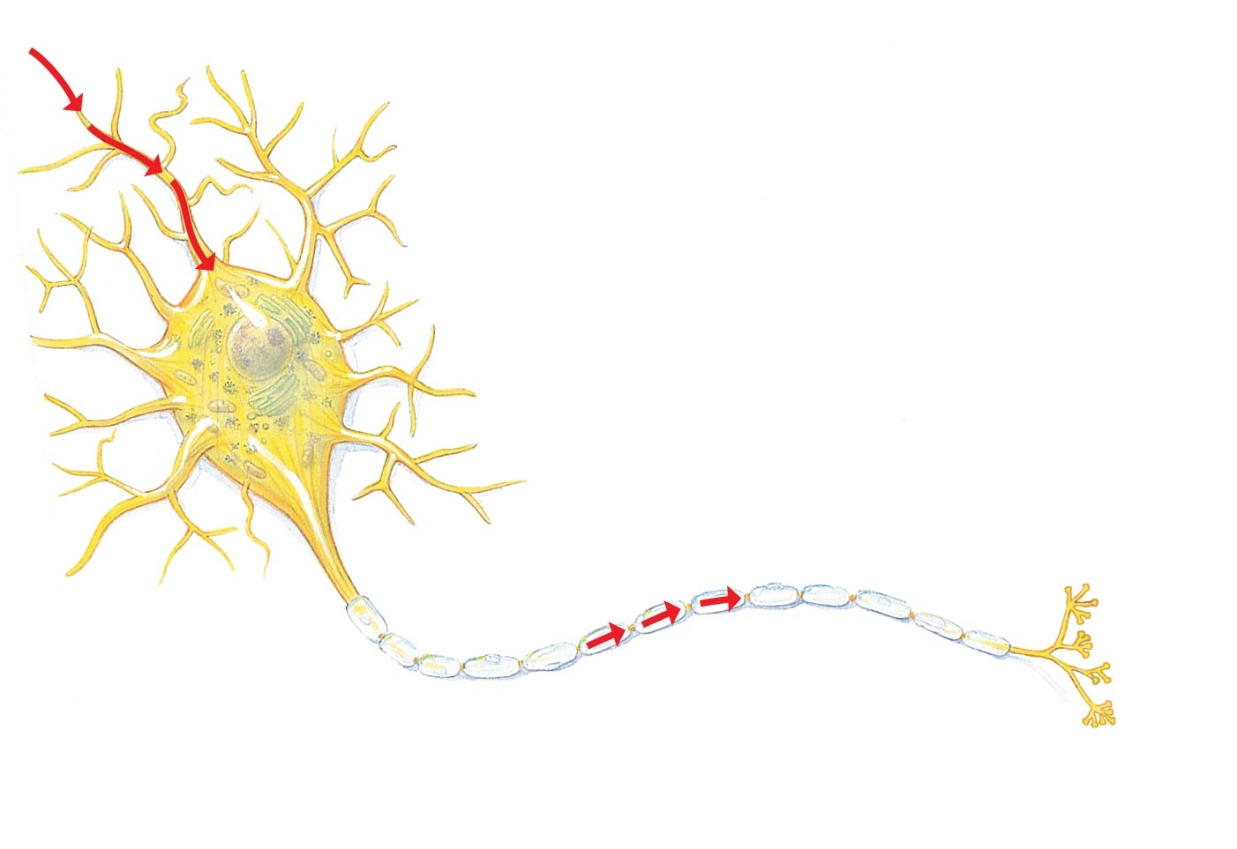
Neurons
Signal direction
Dendrites (树突）
Functional units of the nervous system, vary widely in shape.
Carry electrical signals from one part of the body to another.
Cell Body
Signal
pathway
Synaptic Terminals
Synapse
Supporting
cell
Nucleus
Myelin Sheath, Speed up Transmission
Axon(轴突)
Nerve Fiber

Slide 33
Electrical Properties and Signals of Neurons
By charged ions, not electrons
Resting membrane potential (voltage across the membrane)
  Due to differential distribution of charged ions (K⁺ mainly)
  Negative inside (negatively polarized)
  A universal property for nearly all cells
In excitable cells, neurons, muscles, etc., changes of membrane potentials are employed to send electrical signal
  Action potential, a transient signal that can propagate on the axon and thus can be used to transmitted information in long distance

Slide 34
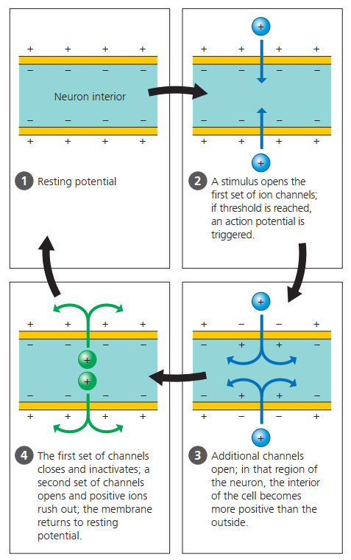
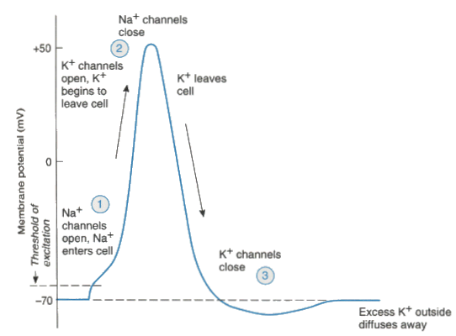
Generation of Action Potential
By inputs from synapses or sensory receptors
Na⁺ in and with a delay K⁺ out
All-or-none

Slide 35
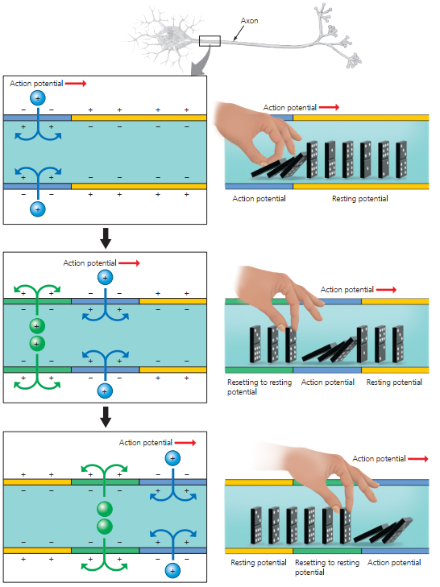
Propagation of Action Potential
Like a “domino effect”
By eliciting action potential in the neighboring membrane down the axon
Unidirectional
Transmission velocity increased by myelin sheath

Slide 36
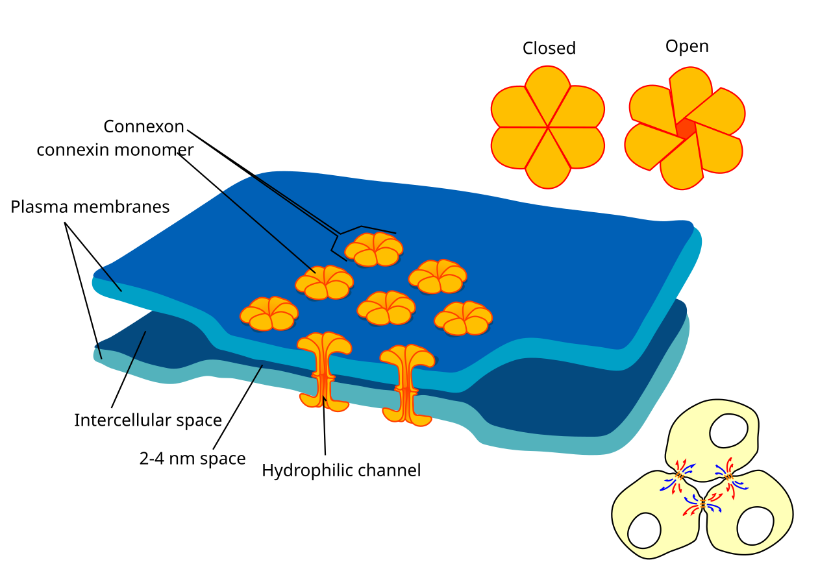
Synaptic Transmission
A synapse (突触) is a relay point between two neurons or between a neuron and an effector cell (e.g. muscle fibers).
Two types
  Electrical synapses
    Continuous by gap junction
    fast and bidirectional coupling
  Chemical synapses
    Separated by synaptic cleft
    Unidirectional
    Diverse effects
By Mariana Ruiz LadyofHats - the diagram i made myself using the information on this websites as source: [1], [2], [3], and[4]. Made with Adobe Illustrator. Image renamed from File:Gap cell junction.svg, Public Domain, https://commons.wikimedia.org/w/index.php?curid=6027074

Slide 37
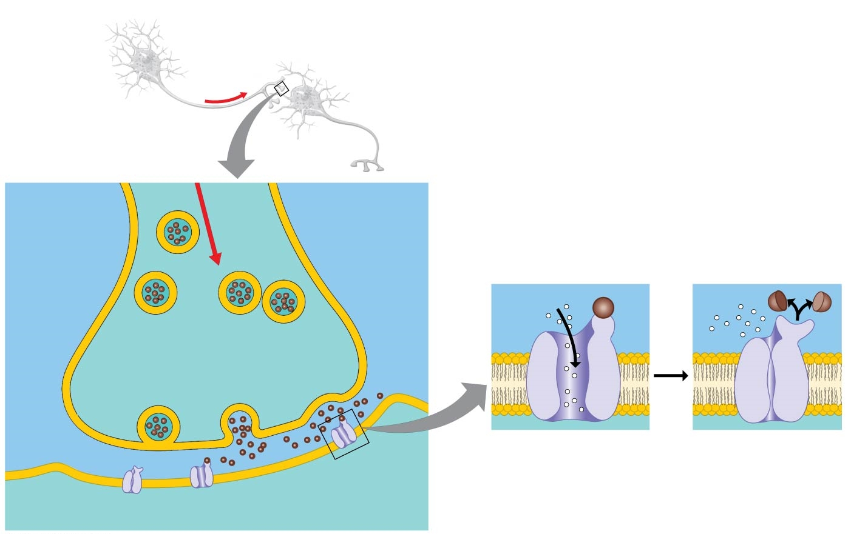
Chemical Synapses
Synaptic
terminal of
sending
neuron
Action potential trigger Ca²⁺ influx
Rising Ca²⁺ level triggers vesicle fusion, release chemicals (neurotransmitters)
Dendrite of
receiving neuron
synapse
Sending
neuron
Vesicles
1
Action
potential
arrives.
Neurotransmitter
Synaptic
terminal
Receptor
Ions
2
Vesicle fuses
with plasma
membrane.
3
Neuro-
transmitter is
released into
synaptic cleft.
Synaptic
cleft
5
Ion channel opens
and triggers or
inhibits a new
action potential.
6
Ion channel closes.
Neurotransmitter is
broken down and
released.
4
Neurotransmitter
binds to receptor.
Receiving
neuron
Ion channels
Neurotransmitter
molecules

Slide 38
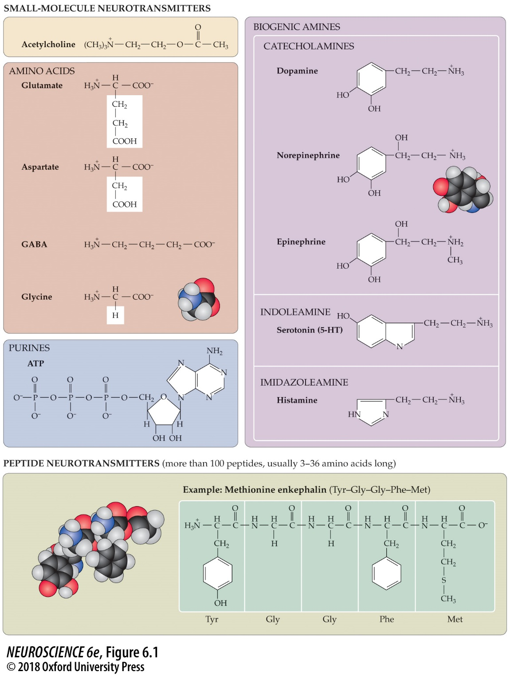
Neurotransmitter (神经递质)
More than 100
Excitatory: acetylcholine, glutamate
Inhibitory: acetylcholine, GABA
Modulatory: dopamine, peptide (e.g., endorphins, natural pain killer)
Diverse ion channel receptors and GPCRs
Peptide neurotransmitters co-released

Slide 39
Drugs in the Brain
Common substances, such as caffeine, nicotine, and alcohol
Prescription drugs, used to treat psychological disorders often alter the effects of neurotransmitters.
  The most commonly prescribed class of antidepressant medications—the selective serotonin reuptake inhibitors (or SSRIs), Zoloft and Prozac— block the reuptake of serotonin.
Illegal drugs, stimulants such as amphetamines and cocaine increase the availability of norepinephrine and dopamine at synapses.
  LSD, marijuana, opiates (morphine, codeine, and heroin), etc.

Slide 40
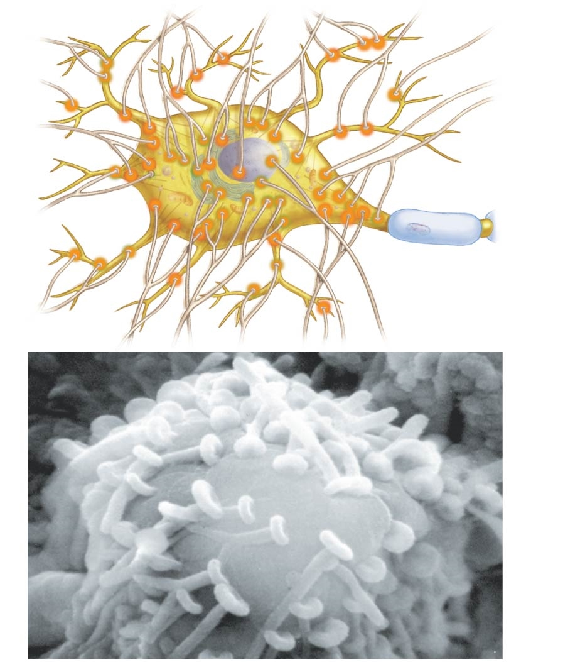
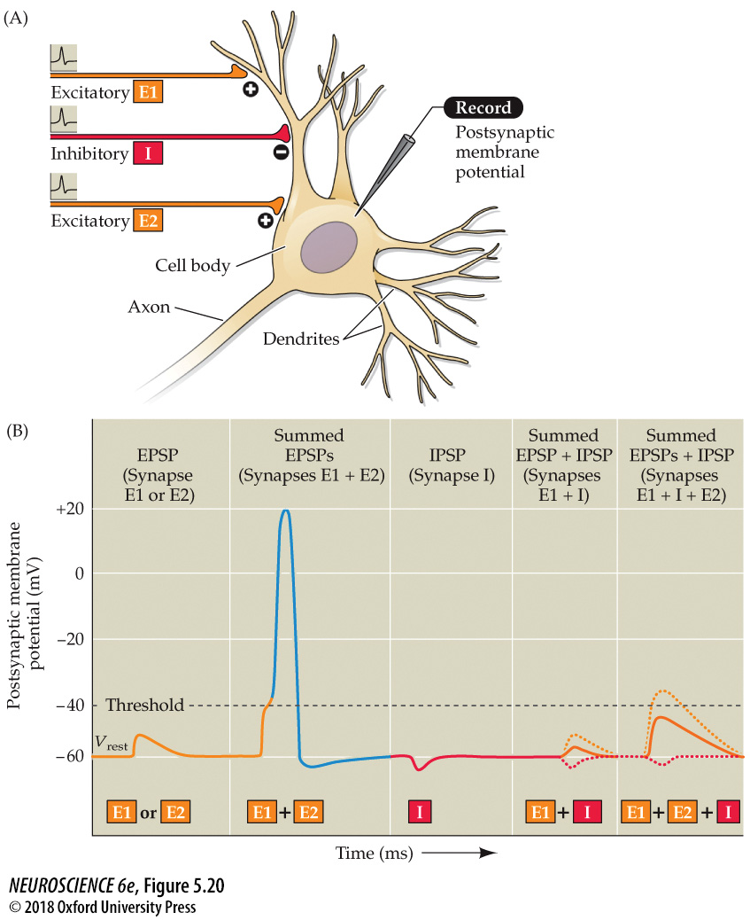
Integration by Cell Body
Dendrites
Myelin
sheath
Receiving
cell body
Axon
Synaptic
terminals
SEM

Slide 41
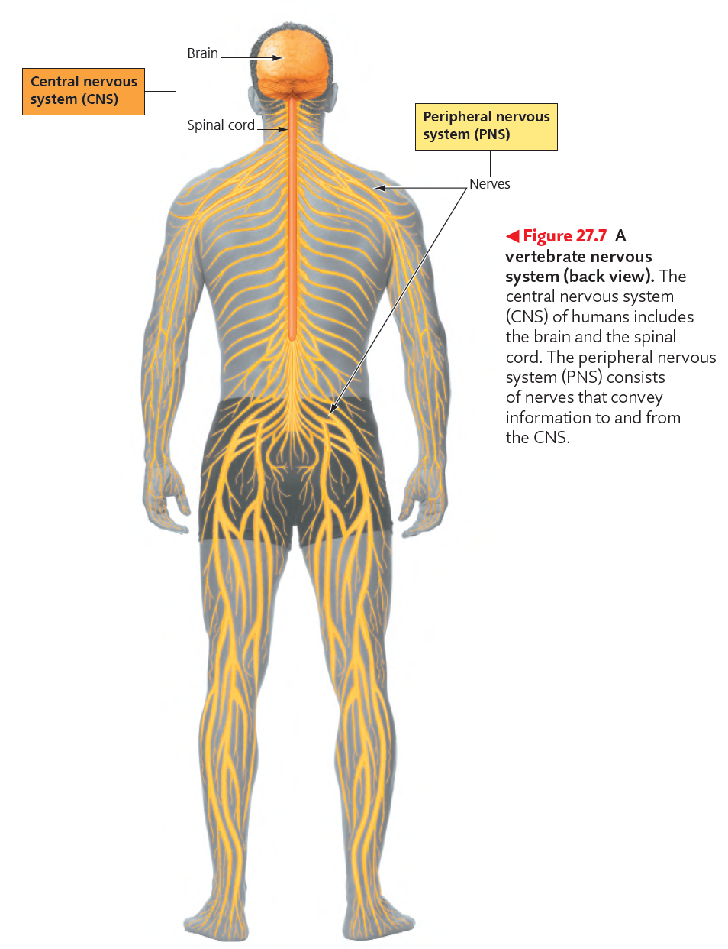
Organization of the Nervous System
The nervous systems of most animals have two main anatomical divisions.
The central nervous system (CNS)
  Brain and spinal cord
  Control center of the nervous system
The peripheral nervous system (PNS)
  Made up mostly of nerves (bundles of axons wrapped in connective tissue)
  Carry signals into and out of the CNS

Slide 42
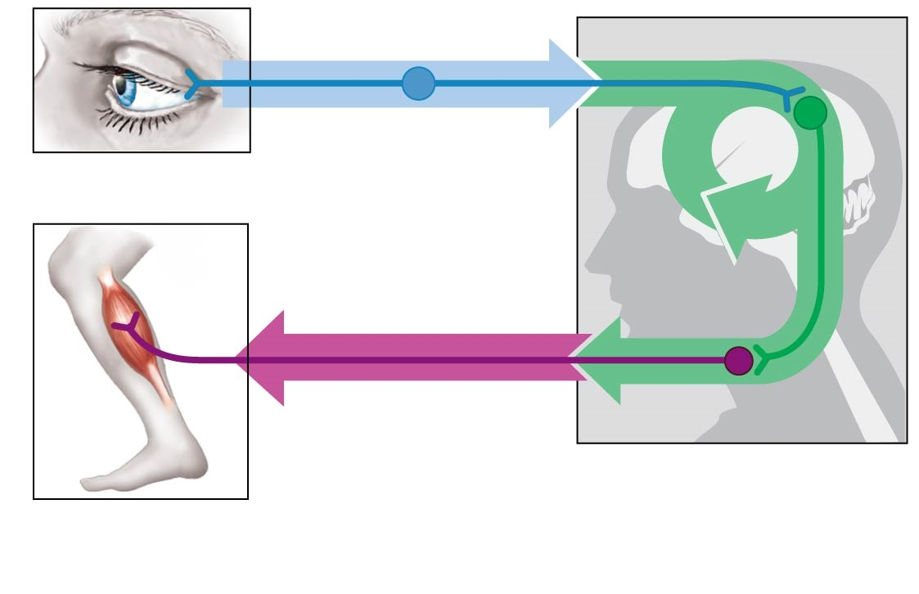
Three Functions by Three Types of Neurons
Sensory Input
Sensory
neurons
Integration
Sensory receptor
Interneurons
（中间神经元）
Motor Output
Motor
neurons
Brain and spinal cord
Effector cells
Peripheral nervous
system (PNS)
Central nervous
system (CNS)

Slide 43
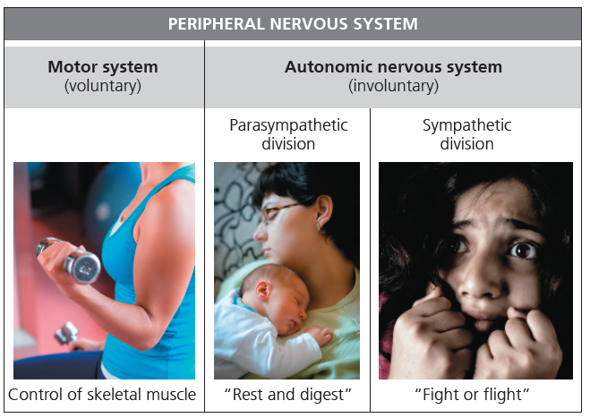
The Peripheral Nervous System
Two functional components
Motor system
  carries signals to and from skeletal muscles
  mainly in response to external stimuli
  voluntary
Autonomic nervous system
  sense and regulate internal environment
  involuntary

Slide 44
The Autonomic Nervous System
By controlling smooth and cardiac muscles and the glands of several body systems: digestive, cardiovascular, excretory, and endocrine systems
Two sets of neurons with opposing effects on most body organs
  The parasympathetic division (副交感神经系统), “rest and digest”
    for activities related to long-term needs of the body
    Stimulate the digestive organs, maintain an active immune response, decrease the heart rate, narrow the bronchi, which correlates with a decreased breathing rate
  The sympathetic division (交感神经系统), “fight or flight”
    for intense, energy-consuming activities
    Inhibit the digestive organs, increase the heart rate, dilate the bronchi, increase breathing rate, secrete the hormones epinephrine (also called adrenaline) and norepinephrine by adrenal gland (endocrine system)

Slide 45
The Central Nervous System (CNS)
The brain
  as the master control center for the nervous system
  integrates data from the sense organs
  sends out commands from motor control centers
The spinal cord
  A bundle of nerve fibers running through the bony spinal column
  A communication conduit between the brain and the rest of the body

Slide 46
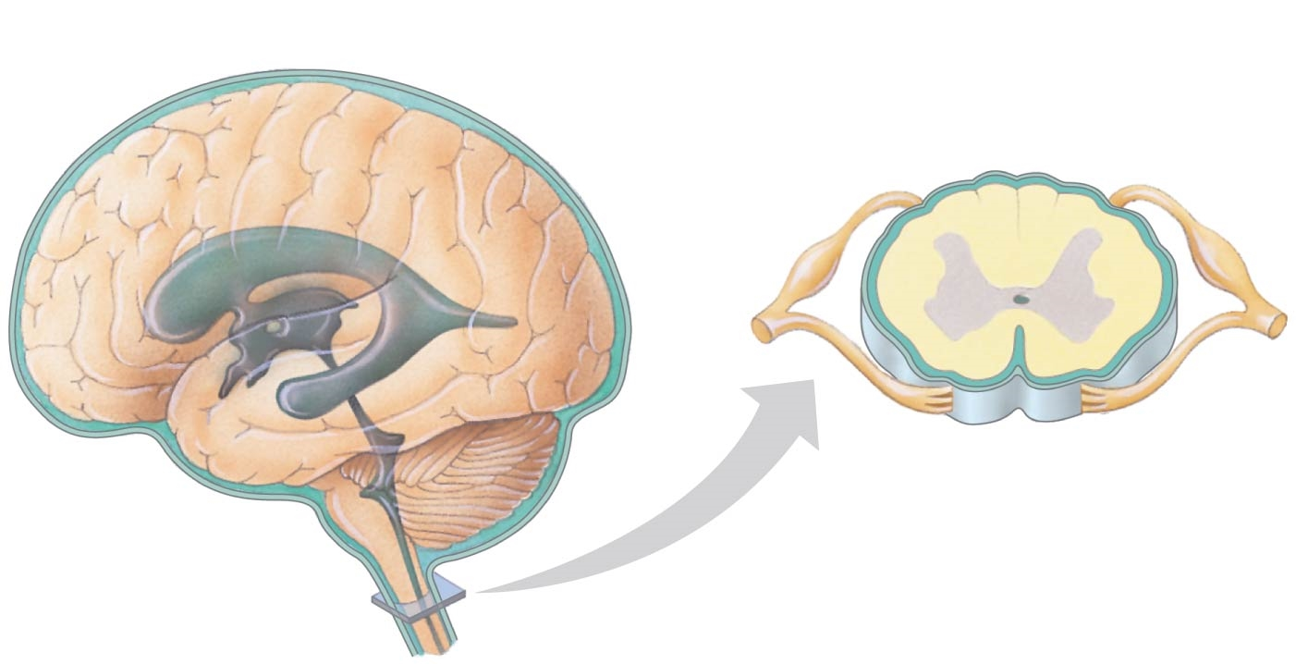
Fluid-filled (“进水”) Spaces (“脑洞”) in CNS
Cerebrospinal fluid (脑脊液)
cushions the CNS
supply nutrients, hormones, and white blood cells
Brain
Meninges (脑膜)
protective layers
Spinal cord
(cross section)
Spinal cord

Slide 47
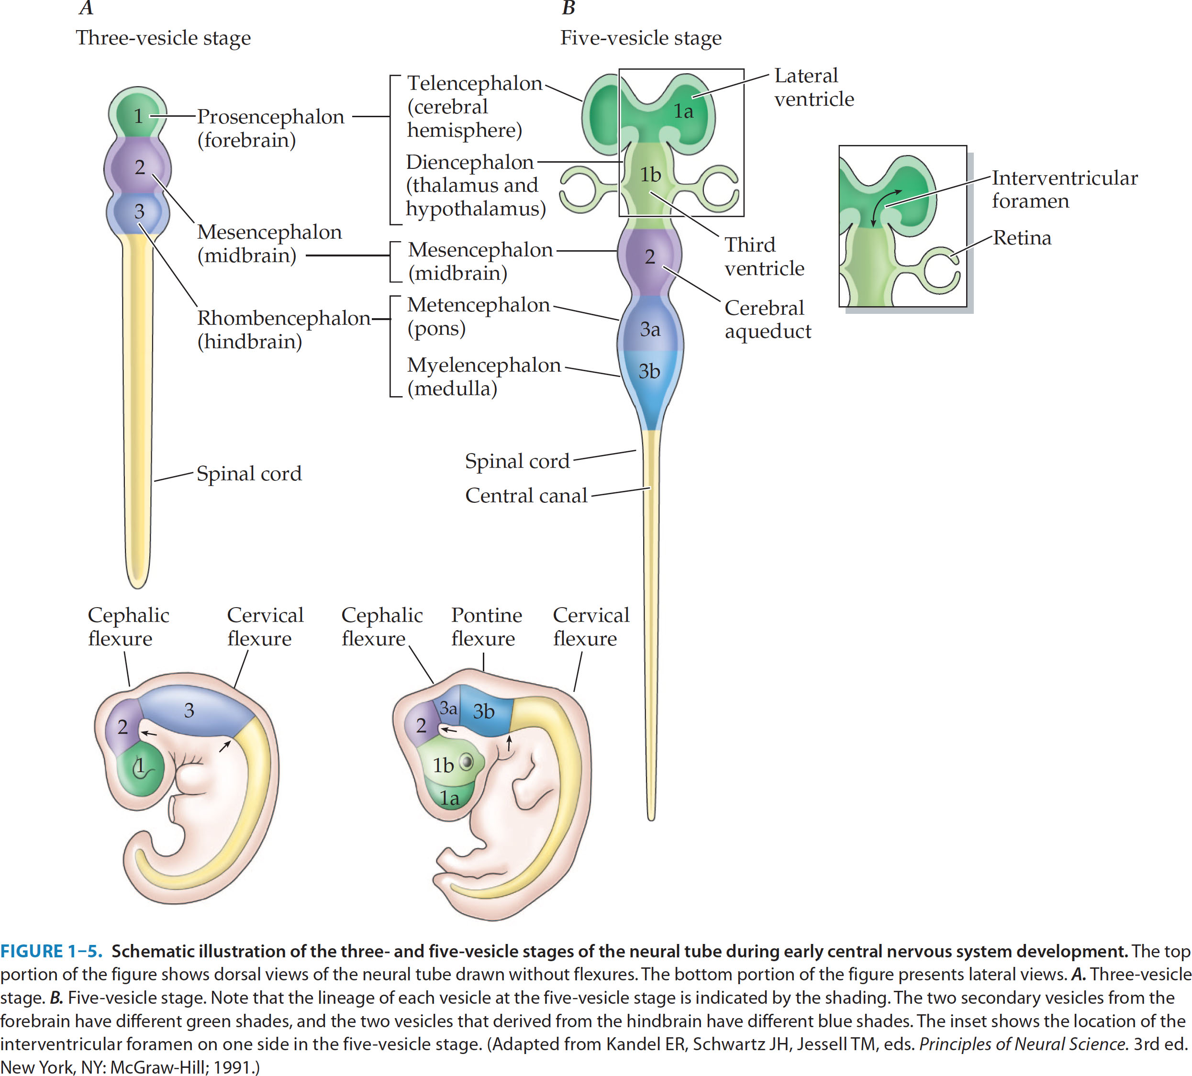
The Human Brain
Up to 100 billion intricately organized neurons
About 10 times more supporting cells (glial cells)
Three regions
  Hindbrain
  Midbrain
  Forebrain

Slide 48
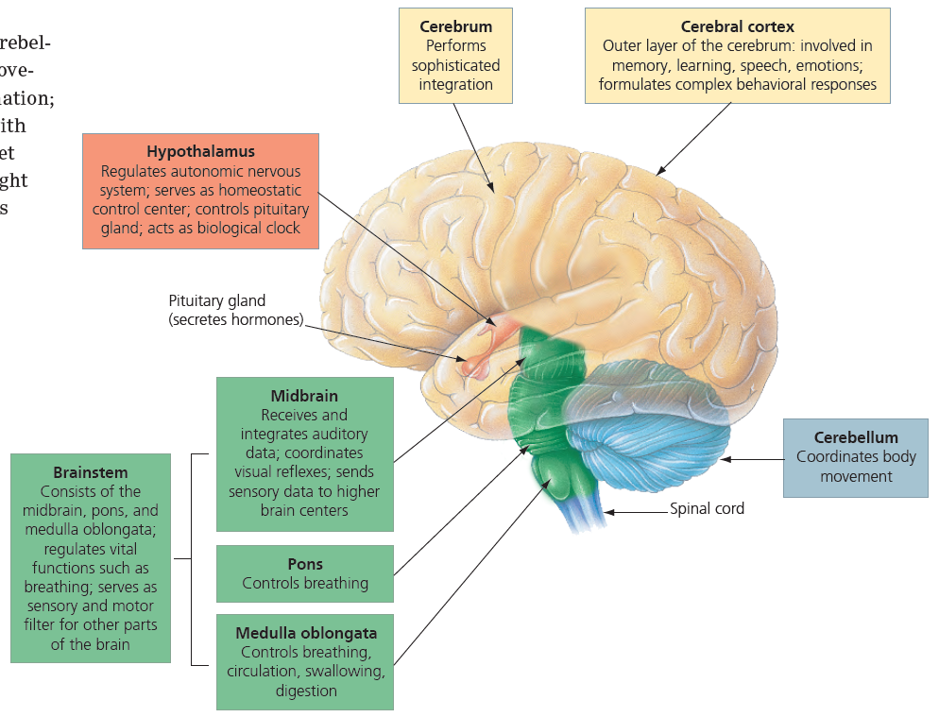
Forebrain
  Cerebrum (大脑)
    Cerebral cortex (大脑皮层)
  Thalamus (丘脑)
    Signal relay and allocation
  Hypothalamus (下丘脑)
Midbrain
Hindbrain
  Pons (脑桥)
    Link to cerebellum
  Medulla Oblongata (延脑)
  Cerebellum (小脑)
    Motor learning

Slide 49
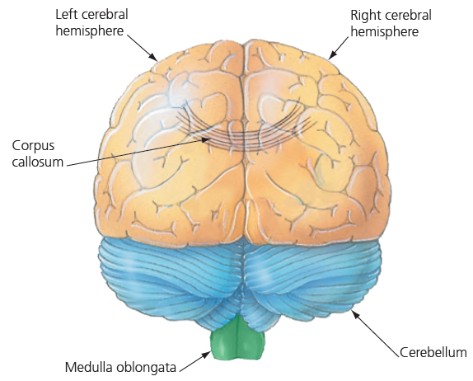
The Cerebral Cortex
The outer layer of the cerebrum
  a thin, highly folded (“wrinkled”) layer of tissue
Right and left hemispheres
Contralateral sensory perception
Contralateral voluntary movements control

Slide 50
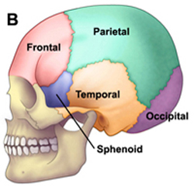
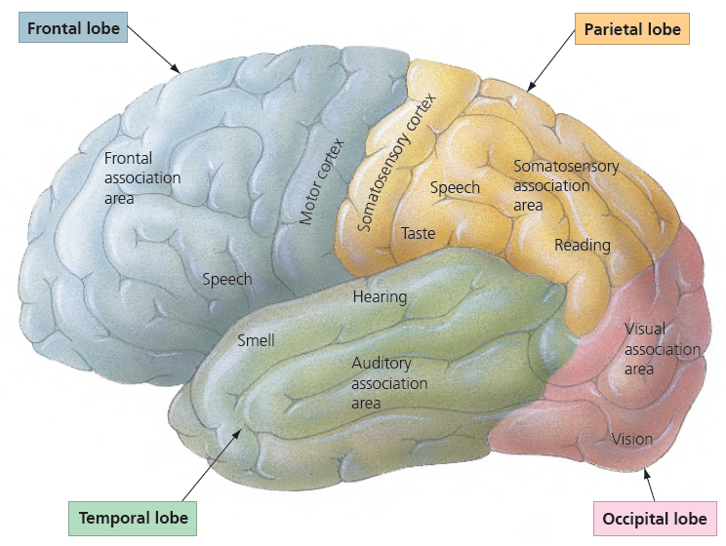
Four Lobes and Functional Areas
Four lobes, each named for a nearby skull bone

Slide 51
How do we know?
Initially, came from observations of patients with damage to one or more of these areas (strokes) and postmortem correlation
Functional mapping at neurosurgery
  Language, motor control
Noninvasive brain imaging of normal subjects,
  e.g. EEG, fMRI, etc.
Electrophysiological analysis of comparable brain regions in non-human animals (in monkeys)

Slide 52
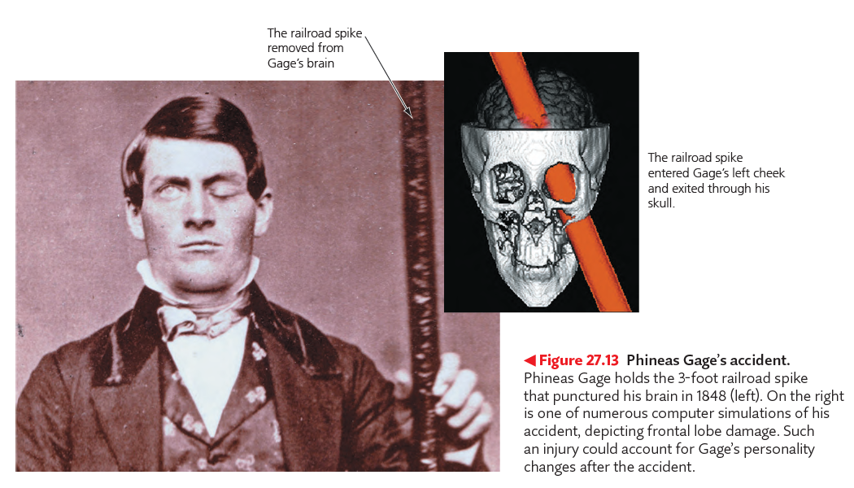
Gage, Personality, and Frontal Lobe Functions

Slide 53
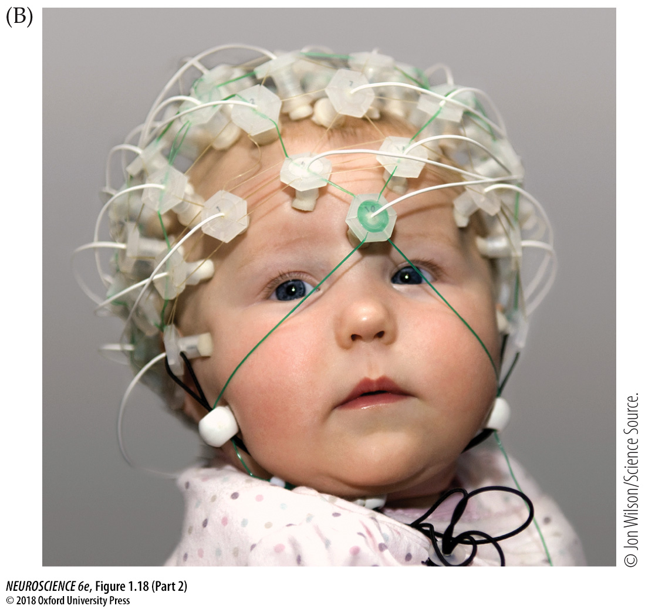

Electroencephalogram (EEG)
Recordings of neural activity at the scalp
Event related potential (ERP) analysis
Good temporal resolution
Non-invasive
Poor spatial resolution
Greater Synchronization Stronger Signal

Slide 54

Neurological Disorders
Alzheimer’s disease (AD) is a form of mental deterioration, or dementia, characterized by confusion, memory loss, and a variety of other symptoms.
  The loss of neurons in the temporal lobe (memory, face recognition)
Major depression may experience sadness, loss of interest in pleasurable activities, changes in body weight and sleep patterns, and suicidal thoughts.

Slide 55
Learning Objectives 3
List and describe the components of signal transduction, and explain how signal transduction is related to sensing and responding to external and internal conditions.
List and describe sensory systems that detect different environmental stimuli, including how sensory structures are related to their functions, and how alteration of structures leads to a loss of sensory function.
Describe the structures, arrangement, and functions of the components of bones and joints, and how skeletal injury and disorders occur and are treated.
Describe the structures, arrangement, and functions of the components of a muscle.

Slide 56
Sensory Systems
To report information to CNS, about the state of the organism itself and its surrounding environment
Visual system, auditory system, somatosensory system…
Depends on sensory organs, sensory cells, sensory receptors
Sensory transduction is the conversion of a stimulus signal to an electrical signal by a sensory receptor cell.
Receptor potentials
  changes in membrane potentials caused by sensory stimuli
  vary in intensity, depending on the strength of the stimulus

Slide 57

Receptor
Sugar
molecule
(stimulus)
1
Membrane
of sensory
receptor cell
2
Signal transduction pathway
Ion
channels
Sugar
molecule
3
Sensory
receptor
cell
Sensory
receptor
cells
Taste bud
Ion
Receptor
potential
4
Neurotransmitter
Action
potential
(to brain)
Sensory
neuron
Sensory neuron

Slide 58
Sensory Adaptation
The tendency of some sensory receptors to become less sensitive when they are stimulated repeatedly.
  A strong order
  Cold water in the swimming pool
  Clothes stick to the skin
Keeps the body from continuously reacting to normal background stimuli.

Slide 59
Sensory Receptors in Five General Categories
Based on the type of signals to which they respond
  Pain receptors (danger, damage, injury or disease)
  Thermoreceptors (sensors for heat and cold)
  Mechanoreceptors (sensors for touch, pressure, motion, and sound)
  Chemoreceptors (sensors for chemicals, nose, taste buds, internal)
  Electromagnetic receptors (sensors for energy such as light and electricity, magnetism)
For the five human senses: earing, smell, taste, touch, vision, and (6th balance)

Slide 60

Receptors in Various Combinations
Each receptor (shown here) serves as both a receptor cell and a sensory neuron
Differs in:
  Types of stimulus
    Specialization at “dendrites”
  Threshold
  Density

Slide 61


The Human Eye
Form images of objects both near and far
Respond to minute amounts of light energy
Detect a multitude of colors
https://commons.wikimedia.org/wiki/File:Farbverlauf_Augenfarben.jpg#/media/File:Farbverlauf_Augenfarben.jpg

Slide 62

Sclera
巩膜
Retina
视网膜
Cornea
角膜
Optic nerve
视神经
Iris 虹膜
Pupil 瞳孔
Lens
水晶体
Blind spot
盲点

Slide 63



Light to the Retina
Focus the light by light refraction
  Cornea, fixed
  Lens, adjustable
    Accommodation, change shape of the lens by muscles
https://share.google/images/kiBbZDbCDJ85jxGAh

Slide 64

Light Detected by Photoreceptors: Rods and Cones
Rods
  are extremely sensitive to light (vision in dim light)
  perceive only shades of gray
  distributed at the outer edges of the retina
Cones
  are less sensitive to light
  can distinguish color (but color-blind)
  are distributed at the retina’s center of focus

Slide 65

Cones and Color Vision
Three types
  Short-wavelength cones (blue)
  Medium-wavelength cones (green)
  Long-wavelength cones (red)
“Color-blind”
Color detection by comparing

Slide 66

The Vision Pathway
Sensory transduction by light-absorbing pigments
Receptor potentials integrated by retinal neurons circuits
Action potentials in optic nerve
Retina
Neurons
Photoreceptors
Cone
Rod
Optic
nerve
fibers
Retina
Optic
nerve
To brain

Slide 67

Imperfect Vision

Slide 68

The Human Ear

Slide 69

The Middle and Inner Ear
Stirrup
Skull bones
Auditory nerve,
to brain
Hammer
Anvil
Eardrum（耳膜）
Cochlea（耳蜗）
Eustachian tube（耳咽管）

Slide 70


In the Cochlea
Cross section
through Cochlea
Bone
Fluid
The organ of Corti
Inner hair cells, the receptor cells of the ear
  Mechanical force into electrical signals
  Receptor potential
  Do not regenerate
Auditory
nerve
Organ of Corti
Overlying membrane
Outer Hair cells
Inner Hair cells
Supporting
cells
Sensory
neurons
Basilar membrane
To auditory
nerve and brain

Slide 71

Hearing Problems
Deafness, the inability to hear, can be caused by
  middle ear infections
  injury, such as a ruptured eardrum
  stiffening of the middle-ear bones (a common age-related problem)
  overexposure to loud noises
  progressive and irreversible

Slide 73
Locomotor (Musculoskeletal) Systems
Movement, one of the most distinctive features of animals
The nervous system issues commands to the muscular system.
The muscular system exerts the forces that make animals move by acting on the skeletal system.

Slide 74

The Skeletal System
Support the whole body
  Trunk
  Limbs
  Cartilage
Anchoring by skeleton muscles
Protection of internal organs

Slide 75

Three Types of Movable Joints
The bones of the skeleton are held together at movable joints by fibrous connective tissues, ligaments

Slide 76

The Structure of Bones
Fibrous connective tissue + Cartilage
Supported by blood vessels
The central cavity of a long bone contains yellow bone marrow, which is mostly stored fat.
The end of a long bone contains red bone marrow, a specialized tissue that produces blood cells.

Slide 77

Skeletal Diseases and Injuries
Broken bone, or fracture
  the most commonly broken bone is the forearm
  for people over 75, the hip
Arthritis (关节炎), an inflammation (发炎) of the joints
Rheumatoid arthritis (类风湿性关节炎), an autoimmune disease
Osteoporosis (骨质疏松), bones become thinner and more porous
  most common in women after menopause

Slide 78

The Muscular System
The muscular system is made of all the skeletal muscles in the body.
Tendons connect muscles to bones.
Antagonistic pairs of muscles produce opposite movements.

Slide 79

The Cellular Basis of Muscle Contraction
Muscle fiber (cell) contains a bundle of smaller myofibrils.
A myofibril (an organelle) consists of repeating units called sarcomeres (contractile unit).
Striated, because the myofibrils exhibit alternating light and dark bands when viewed with a light microscope

Slide 80


The Sliding-filament Model of Muscle Contraction
A sarcomere contracts (shortens) when its thin filaments slide past its thick filaments.
TEM
Thick
filaments
(myosin)
Light
band
Light
band
Dark band
Thin
filaments
(actin)
Sarcomere

Slide 81

The Mechanism of Filament Sliding
Thick filament (myosin)
Myosin head
(low-energy
configuration)
Myosin head
(high-energy
configuration)
Thin filament
(actin)
ATP
ATP
ADP
P
1
ATP binds to a myosin head, which is
then released from an actin filament.
2
The breakdown of ATP cocks the
myosin head.
3
The myosin head attaches to an actin
binding site.
4
The power stroke slides the actin
(thin) filament toward the center of the
sarcomere.
5
As long as ATP is available, the
process can be repeated until the
muscle is fully contracted.

Slide 82

Motor Unit
A motor unit consists of a motor neuron and all the muscle fibers it controls
Each motor neuron may serve just one or up to several hundred fibers scattered throughout a muscle.
Force of contraction depends on:
  Number and types of motor units
  Frequency of stimulation

